Slide 1
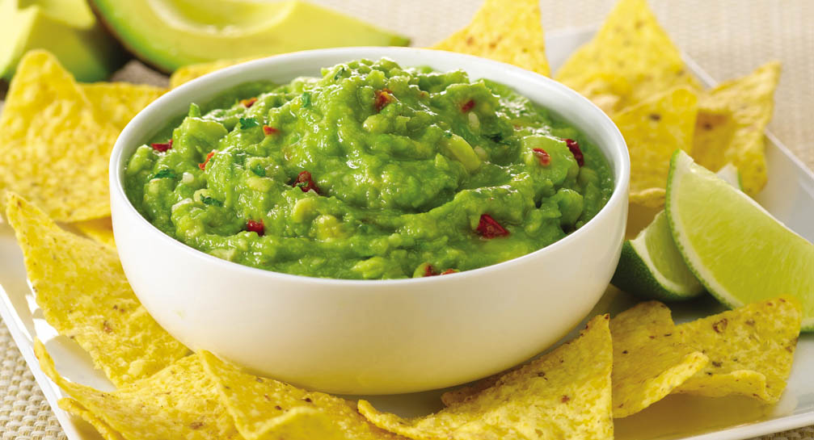

Musical Guacamole
John Matthew Bandelaria and Tong Chen
7th Period

Slide 2
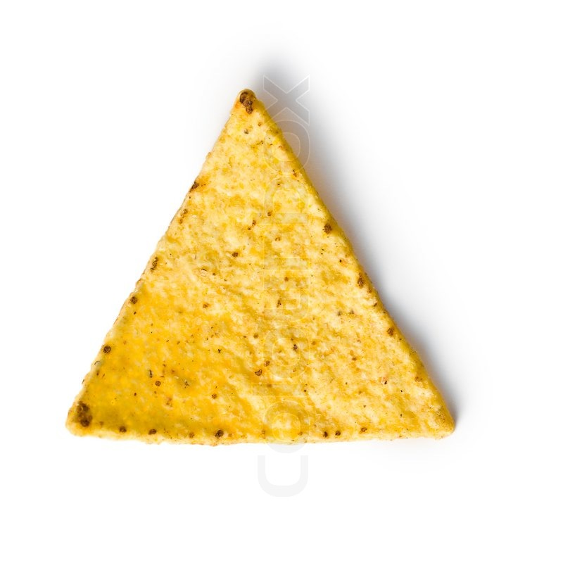
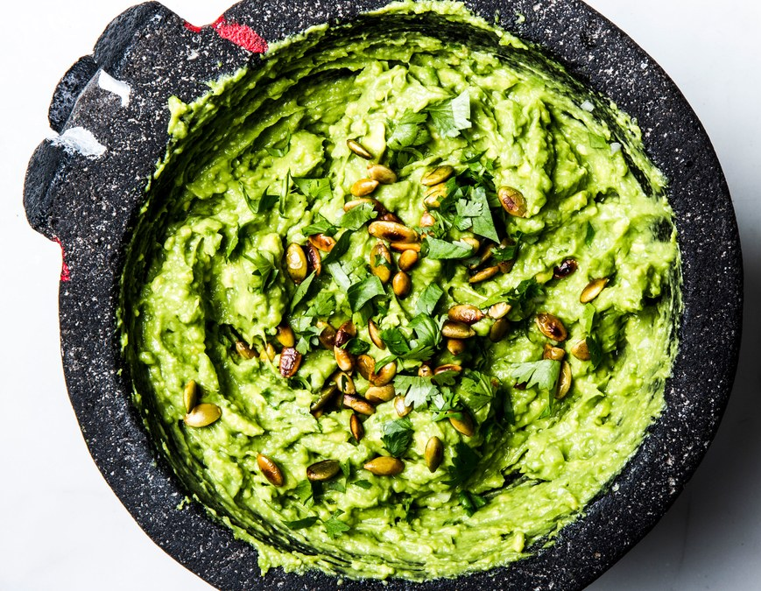
POV
Guacamole (Antagonist), white is movement
Nacho Chip (protagonist)
Exit

Slide 3
POV
Guacamole (Antagonist), white is movement
Chippy (protagonist)
Exit

Slide 4
Main Classes
Draw Map
Textures and Images
Run Game
Key Listener
Player
Enemy
Sound Control

Slide 5
Possible game extension classes
Level Generator
Enemy level scaling
Difficulty Increaser
Player skills(part of player class)
Items/Powerups

Slide 6
Draw Map Class
Tilemap
Use textures and stuff from the other class
Places where you can walk are certain locations with a boolean and player can only travel if there bool is true(to emulate walls)
End and beginning spots

Slide 7
Textures and Images
Textures like notes we took over block the pig
Use graphics to take images to make textures

Slide 8
Run Game
Uses draw map, player, enemy, key listener, and sound control classes
Constantly runs game
Uses the window thing
Uses the thing where it only refreshes the page with an image of all the pieces

Slide 9
Key Listener
KEY_EVENT
Booleans isHold, isPressed, stuff like that
Record which key is pressed to determine move direction

Slide 10
Player
Generates textures of player into nacho chip shape
Determines field of view in total game generation view
Map was generated by draw map but then a black view obscurer blocks everything except the player field of view
Player movement

Slide 11
Enemy
Guacamole textures and generation
Movement paths
Player detection
Changes sound as gets closer to player

Slide 12
Sound control
Sets the sound file to play on loop
Functionality to change sound of the file dynamically during the game
Default is 0 sound

